Slide 1
Introduction to Job Submission with HTCondor
June 23, 2024
Amber Lim
Slides adapted from Lauren Michaels, Rachel Lombardi, Andrew Owen
This work was supported by NSF grants MPS-1148698, OAC-1836650, and OAC-2030508

Slide 2
Objective
By the end of this session, you should be able to:
Describe how the HTCondor manages workflows
Translate your computational tasks to “jobs”
Run, monitor, and review your jobs
Submit multiple jobs using multiple methods
Test, tune, and troubleshoot your workflow

Slide 3
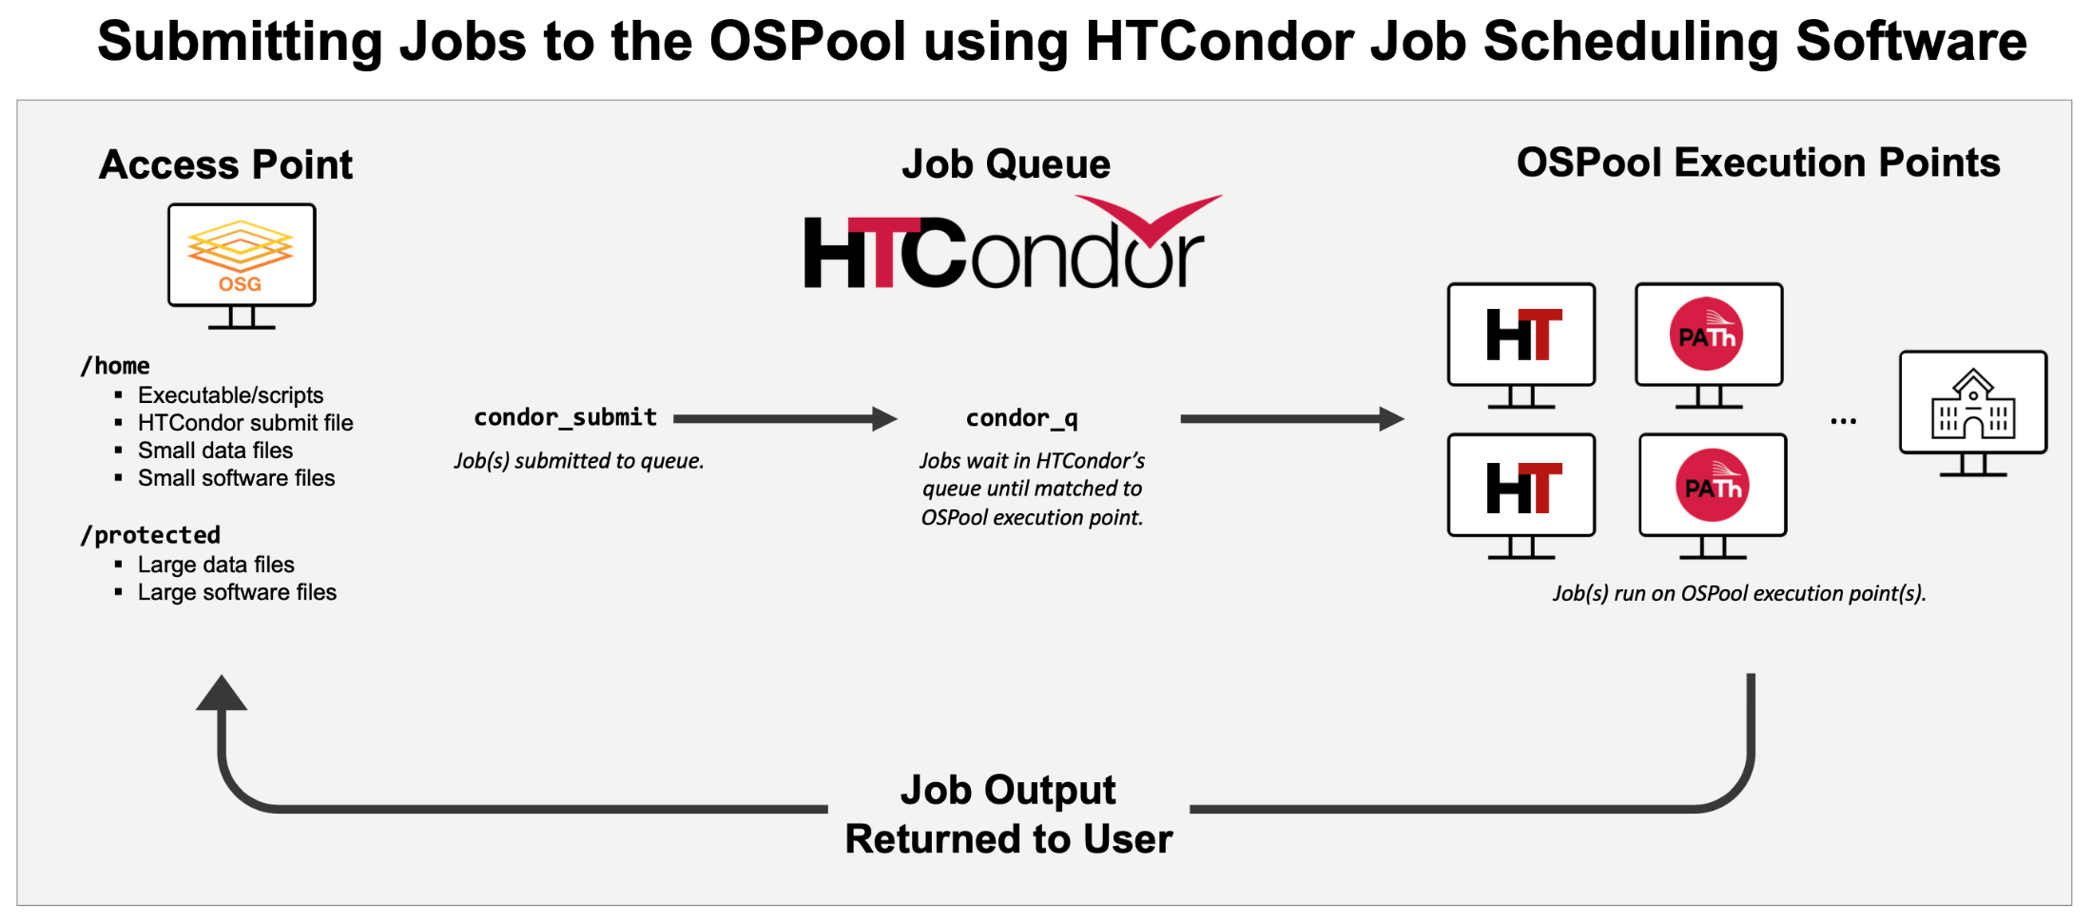
Takeaway
HTCondor is a Job Scheduling Software

Slide 4
History of HTCondor

Slide 5


HTCondor History and Status
Beginnings
Started in 1988 as a “cycle scavenger”
Today
Developed at CHTC by professional developers
Used all over the world, by:
Campuses, national labs, Einstein/Folding@Home
Dreamworks, Boeing, SpaceX, investment firms, …
The OSPool!!
Miron Livny
Professor, UW-Madison Computer Sciences
CHTC Director, OSG Technical Director

Slide 6
How does HTCondor work?

Slide 7





HTCondor — How It Works
You create and describe your tasks on the Access Point.
You submit tasks to HTCondor on an Access Point.
HTCondor schedules your tasks to run on Execution Points
Access Point
Execution Point
tasks
Execution Point
Execution Point

Slide 8



HTCondor — How It Works
You create and describe your tasks on the Access Point.
You submit tasks to HTCondor on an Access Point.
HTCondor schedules your tasks to run on Execution Points
Access Point
Your computer

Slide 9
Terminology: Job
Job: An independently-scheduled unit of computing work
Three main pieces:
Executable: the script or program to run
Input: any options (arguments) and/or file-based information
Output: files printed by the executable
Note: In order to run many jobs, executable must run on the command-line without any graphical input from the user

Slide 10

Terminology: Machine, Slot
Machine
A whole computer (desktop or server)
Has multiple processors (CPU cores), some amount of memory, and some amount of file space (disk)
Slot
an assignable unit of a machine (i.e. 1 job per slot)
may correspond to one core with some memory and disk
a typical machine will have multiple slots
HTCondor can break up and create new slots, dynamically, as resources become available from completed jobs

Slide 11




Job Matching
On a regular basis, the central manager reviews Job and Machine attributes and matches jobs to Slots.
execute point
access point
central manager
execute point
execute point
11

Slide 12
Job Execution
Then the Access and Execution points communicate directly.
execute point
access point
central manager
execute point
execute point
12

Slide 13
Basics of submitting jobs

Slide 14
HTCondor — How It Works
You create and describe your tasks on the Access Point.
You submit tasks to HTCondor on an Access Point.
HTCondor schedules your tasks to run on Execution Points
Access Point
Execution Point
tasks
Execution Point
Execution Point

Slide 15
Terminology: Job
Job: An independently scheduled unit of computing work
Three main pieces:
Executable: the script or program to run
Input: any options (arguments) and/or file-based information
Output: files printed by the executable
Note: In order to run many jobs, executable must run on the command-line without any graphical input from the user

Slide 16





Components of a job
Software environment
What software, packages, and libraries do you need?
Executable + arguments
How do you run your computation?
Input files/output files
What input files are needed? What output files are created?
Standard output/error
Where do you save messages printed to the screen?
Requirements
What resources (CPU, GPU, memory, disk) do you need?
Notes:
Make these into tiles

Slide 17
Components of a job
Software environment
What software, packages, and libraries do you need?
We will cover Software on Tuesday!
Executable + arguments
How do you run your computation?
Input files/output files
What input files are needed? What output files are created?
Standard output/error
Where do you save messages printed to the screen?
Requirements
What resources (CPU, GPU, memory, disk) do you need?
Notes:
Make these into tiles

Slide 18
Job Example
Imagine you are a researcher who needs to compare each state’s data to national data.
One comparison takes a few hours.
Each comparison is independent.
wi.dat
il.dat
us.dat
+
mi.dat
mn.dat

Slide 19
Command for One Task
Your program called “compare_states” (executable), which compares two data files (input) and produces a single output file.
wi.dat
compare_
states
wi.dat.out
us.dat
$ compare_states wi.dat us.dat wi.dat.out

Slide 20
HTCondor Submit File
executable = compare_states
arguments = wi.dat us.dat wi.dat.out
transfer_input_files = us.dat, wi.dat
log = job.log
output = job.out
error = job.err
request_cpus = 1
request_disk = 20MB
request_memory = 20MB
queue 1

Slide 21
HTCondor Submit File
executable = compare_states
arguments = wi.dat us.dat wi.dat.out
transfer_input_files = us.dat, wi.dat
log = job.log
output = job.out
error = job.err
request_cpus = 1
request_disk = 20MB
request_memory = 20MB
queue 1
List your executable and any arguments it takes
Arguments are any options passed to the executable from the command line
$ compare_states wi.dat us.dat wi.dat.out

Slide 22
HTCondor Submit File
executable = compare_states
arguments = wi.dat us.dat wi.dat.out
transfer_input_files = us.dat, wi.dat
log = job.log
output = job.out
error = job.err
request_cpus = 1
request_disk = 20MB
request_memory = 20MB
queue 1
Provide HTCondor a comma-separated list of input files to transfer to the slot
wi.dat
us.dat
The Access Point and the Execution Point are separate machines, so we must specify which files to transfer.

Slide 23
HTCondor Submit File
executable = compare_states
arguments = wi.dat us.dat wi.dat.out
transfer_input_files = us.dat, wi.dat
log = job.log
output = job.out
error = job.err
request_cpus = 1
request_disk = 20MB
request_memory = 20MB
queue 1
HTCondor will transfer back all new and changed files (output) from the job, automatically.
wi.dat.out

Slide 24
HTCondor Submit File
executable = compare_states
arguments = wi.dat us.dat wi.dat.out
transfer_input_files = us.dat, wi.dat
log = job.log
output = job.out
error = job.err
request_cpus = 1
request_disk = 20MB
request_memory = 20MB
queue 1
log: file created by HTCondor to track job progress
Explored in exercises!
output/error: captures stdout and stderr from your program (what would otherwise be printed to the terminal)

Slide 25
HTCondor Submit File
executable = compare_states
arguments = wi.dat us.dat wi.dat.out
transfer_input_files = us.dat, wi.dat
log = job.log
output = job.out
error = job.err
request_cpus = 1
request_disk = 20MB
request_memory = 20MB
queue 1
request_cpus, request_disk, request_memory:
the resources your job needs.

Slide 26
HTCondor Submit File
executable = compare_states
arguments = wi.dat us.dat wi.dat.out
transfer_input_files = us.dat, wi.dat
log = job.log
output = job.out
error = job.err
request_cpus = 1
request_disk = 20MB
request_memory = 20MB
queue 1
Very important to request appropriate resources (memory, cpus, disk)
requesting too little: causes problems for your jobs; jobs might by ‘held’ by HTCondor
requesting too much: jobs will match to fewer “slots” than they could, and you’ll block other jobs

Slide 27
HTCondor Submit File
executable = compare_states
arguments = wi.dat us.dat wi.dat.out
transfer_input_files = us.dat, wi.dat
log = job.log
output = job.out
error = job.err
request_cpus = 1
request_disk = 20MB
request_memory = 20MB
queue 1
queue: keyword indicating the number of jobs to queue
- must be the last line of the submit file
- has different syntax options we will learn later!

Slide 28
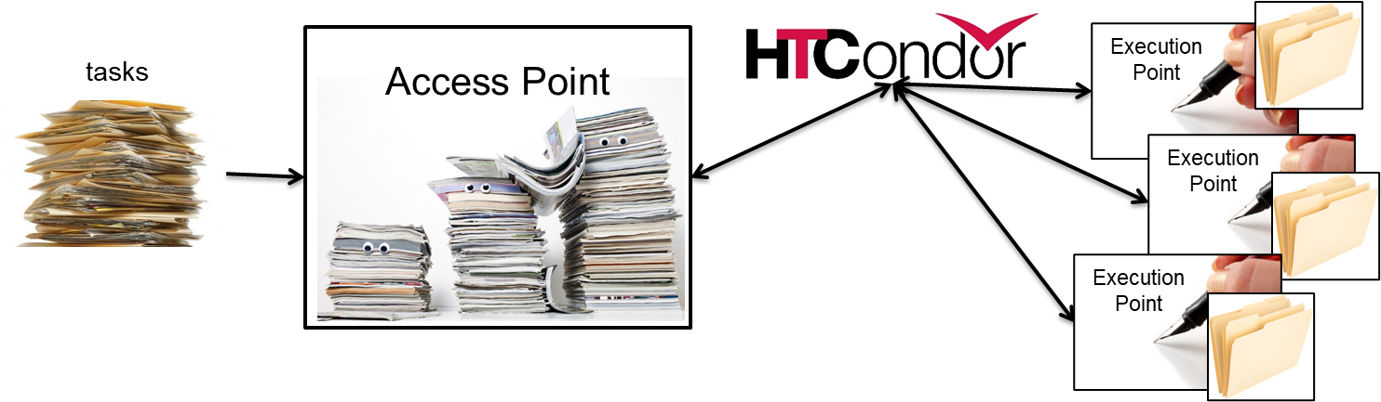
Let’s pause!
executable = compare_states
arguments = wi.dat us.dat wi.dat.out
transfer_input_files = us.dat, wi.dat
log = job.log
output = job.out
error = job.err
request_cpus = 1
request_disk = 20MB
request_memory = 20MB
queue 1
What questions do you have about—
How HTCondor works?
Components of a job?
The HTCondor submit file?

Slide 29
Submitting and monitoring HTCondor jobs

Slide 30
HTCondor — How It Works
You create and describe your tasks on the Access Point.
You submit tasks to HTCondor on an Access Point.
HTCondor schedules your tasks to run on Execution Points
Access Point
Execution Point
tasks
Execution Point
Execution Point

Slide 31
Submitting and Monitoring
Submit jobs on the Access Point
To submit jobs: condor_submit submit_file
To monitor submitted jobs: condor_q
$ condor_submit job.submit
Submitting job(s).
1 job(s) submitted to cluster 128.
$ condor_q
-- Schedd: ap40.uw.osg-htc.org : <128.105.68.62:9618> @ 08/01/24 10:35:54
OWNER BATCH_NAME SUBMITTED DONE RUN IDLE TOTAL JOB_IDS
alice ID:128 8/1 10:05 _ _ 1 1 128.0
1 jobs; 0 completed, 0 removed, 1 idle, 0 running, 0 held, 0 suspended
HTCondor Manual: condor_submit
HTCondor Manual: condor_q

Slide 32
More about condor_q
By default, condor_q …
Only shows your jobs and not anyone else’s
Groups jobs that were submitted together (“batch” or “cluster”)
Only shows active batches
Limit condor_q by username, ClusterId or full JobId, (denoted [U/C/J] in following slides).
$ condor_q
-- Schedd: ap40.uw.osg-htc.org : <128.105.68.62:9618> @ 08/01/24 10:35:54
OWNER BATCH_NAME SUBMITTED DONE RUN IDLE TOTAL JOB_IDS
alice CMD: compare_states 8/1 10:09 3 4 3 10 129.0-9
10 jobs; 3 completed, 0 removed, 3 idle, 4 running, 0 held, 0 suspended
JobId = ClusterID.ProcID

Slide 33
More about condor_q
To see individual job details, use:
condor_q –nobatch
We will use the -nobatch option in the following slides to see extra detail about what is happening with a job
$ condor_q -nobatch
-- Schedd: ap40.uw.osg-htc.org : <128.105.68.62:9618>
ID OWNER SUBMITTED RUN_TIME ST PRI SIZE CMD
129.0 alice 8/1 10:09 0+00:00:00 I 0 0.0 compare_states
129.1 alice 8/1 10:09 0+00:00:00 R 0 0.0 compare_states
...
7 jobs; 0 completed, 0 removed, 3 idle, 4 running, 0 held, 0 suspended

Slide 34
Monitoring Jobs with condor_q

Slide 35
HTCondor — How It Works
You create and describe your tasks on the Access Point.
You submit tasks to HTCondor on an Access Point.
HTCondor schedules your tasks to run on Execution Points
Access Point
Execution Point
tasks
Execution Point
Execution Point

Slide 36
Job Idle
$ condor_q -nobatch
-- Schedd: ap40.uw.osg-htc.org : <128.105.68.62:9618>
ID OWNER SUBMITTED RUN_TIME ST PRI SIZE CMD
128.0 alice 8/1 10:05 0+00:00:00 I 0 0.0 compare_states wi.dat us.dat
Total for query: 1 jobs; 0 completed, 0 removed, 1 idle, 0 running, 0 held, 0 suspended
Access Point
(submit_dir)/
job.submit
compare_states
wi.dat
us.dat
job.log
job.out
job.err

Slide 37
Job Starts
$ condor_q -nobatch
-- Schedd: ap40.uw.osg-htc.org : <128.105.68.62:9618>
ID OWNER SUBMITTED RUN_TIME ST PRI SIZE CMD
128.0 alice 8/1 10:05 0+00:00:00 < 0 0.0 compare_states wi.dat us.dat
Total for query: 1 jobs; 0 completed, 0 removed, 1 idle, 0 running, 0 held, 0 suspended
Access Point
Execute Point
(execute_dir)/
(submit_dir)/
job.submit
compare_states
wi.dat
us.dat
job.log
job.out
job.err
(execute_dir)/
compare_states
wi.dat
us.dat

Slide 38
Job Running
$ condor_q -nobatch
-- Schedd: ap40.uw.osg-htc.org : <128.105.68.62:9618>
ID OWNER SUBMITTED RUN_TIME ST PRI SIZE CMD
128.0 alice 8/1 10:05 0+00:00:00 R 0 0.0 compare_states wi.dat us.dat
Total for query: 1 jobs; 0 completed, 0 removed, 0 idle, 1 running, 0 held, 0 suspended
Access Point
Execute Point
(submit_dir)/
job.submit
compare_states
wi.dat
us.dat
job.log
job.out
job.err
(execute_dir)/
compare_states
wi.dat
us.dat
stderr
stdout
wi.dat.out
subdir/tmp.dat

Slide 39
Job Completes
$ condor_q -nobatch
-- Schedd: ap40.uw.osg-htc.org : <128.105.68.62:9618>
ID OWNER SUBMITTED RUN_TIME ST PRI SIZE CMD
128.0 alice 8/1 10:05 0+00:00:00 > 0 0.0 compare_states wi.dat us.dat
Total for query: 1 jobs; 0 completed, 0 removed, 0 idle, 1 running, 0 held, 0 suspended
Access Point
Execute Point
(submit_dir)/
job.submit
compare_states
wi.dat
us.dat
job.log
job.out
job.err
(execute_dir)/
compare_states
wi.dat
us.dat
stderr
stdout
wi.dat.out
subdir/tmp.dat
stderr
stdout
wi.dat.out

Slide 40
Job Completes (cont.)
$ condor_q -nobatch
-- Schedd: ap40.uw.osg-htc.org : <128.105.68.62:9618>
ID OWNER SUBMITTED RUN_TIME ST PRI SIZE CMD
Total for query: 0 jobs; 0 completed, 0 removed, 0 idle, 0 running, 0 held, 0 suspended
Access Point
(submit_dir)/
job.submit
compare_states
wi.dat
us.dat
job.log
job.out
job.err
wi.dat.out
Job completed →
Disappears from condor_q output!

Slide 41
Reviewing Completed Jobs

Slide 42
Log File
000 (128.000.000) 2024-08-01 10:05:08 Job submitted from host: <128.104.101.92>
...
001 (128.000.000) 2024-08-01 10:05:46 Job executing on host: <128.104.101.128:9618>
...
006 (128.000.000) 2024-08-01 10:07:54 Image size of job updated: 220
1 - MemoryUsage of job (MB)
220 - ResidentSetSize of job (KB)
...
005 (128.000.000) 2024-08-01 10:12:48 Job terminated.
(1) Normal termination (return value 0)
Usr 0 00:00:00, Sys 0 00:00:00 - Run Remote Usage
Usr 0 00:00:00, Sys 0 00:00:00 - Run Local Usage
Usr 0 00:00:00, Sys 0 00:00:00 - Total Remote Usage
Usr 0 00:00:00, Sys 0 00:00:00 - Total Local Usage
0 - Run Bytes Sent By Job
33 - Run Bytes Received By Job
0 - Total Bytes Sent By Job
33 - Total Bytes Received By Job
Partitionable Resources : Usage Request Allocated
Cpus : 1 1
Disk (KB) : 14 20480 17203728
Memory (MB) : 1 20 20

Slide 43
Reviewing Jobs
To review a large group of jobs at once, use condor_history
As condor_q is to the present, condor_history is to the past
$ condor_history alice
ID OWNER SUBMITTED RUN_TIME ST COMPLETED CMD
189.1012 alice 5/11 09:52 0+00:07:37 C 5/11 16:00 /home/alice
189.1002 alice 5/11 09:52 0+00:08:03 C 5/11 16:00 /home/alice
189.1081 alice 5/11 09:52 0+00:03:16 C 5/11 16:00 /home/alice
189.944 alice 5/11 09:52 0+00:11:15 C 5/11 16:00 /home/alice
189.659 alice 5/11 09:52 0+00:26:56 C 5/11 16:00 /home/alice
189.653 alice 5/11 09:52 0+00:27:07 C 5/11 16:00 /home/alice
189.1040 alice 5/11 09:52 0+00:05:15 C 5/11 15:59 /home/alice
189.1003 alice 5/11 09:52 0+00:07:38 C 5/11 15:59 /home/alice
189.962 alice 5/11 09:52 0+00:09:36 C 5/11 15:59 /home/alice
189.961 alice 5/11 09:52 0+00:09:43 C 5/11 15:59 /home/alice
189.898 alice 5/11 09:52 0+00:13:47 C 5/11 15:59 /home/alice
HTCondor Manual: condor_history

Slide 44
Watching Job Progress with condor_watch_q

Slide 45
Watching Progress of Jobs
To get a live update of the progress of your jobs, use condor_watch_q
This command does an initial condor_q and then tracks the entries of the corresponding .log file(s)
$ condor_watch_q
BATCH IDLE RUN DONE TOTAL JOB_IDS
ID: 129 10 - - 10 129.0 ... 129.9 [--------------------]
[-------------------------------------------------------------------------]
Total: 10 jobs; 10 idle
Updated at 2024-08-01 10:10:32
Input ^C to exit
HTCondor Manual: condor_watch_q

Slide 46
Watching Progress of Jobs
As the work progresses, output updates with changes to the progress bar
updates every 2 seconds
$ condor_watch_q
BATCH IDLE RUN DONE TOTAL JOB_IDS
ID: 129 9 1 - 10 129.0 ... 129.9 [==------------------]
[=======------------------------------------------------------------------]
Total: 10 jobs; 9 idle, 1 running
Updated at 2024-08-01 10:10:52
Input ^C to exit
HTCondor Manual: condor_watch_q

Slide 47
Watching Progress of Jobs
Yellow hyphens (-) = “idle”
Blue greater than signs (>) = “transferring files”
Blue equal signs (=) = “running”
Green number signs (#) = “completed”
Red exclamation marks (!) = “hold”
$ condor_watch_q
BATCH IDLE RUN DONE TOTAL JOB_IDS
ID: 129 3 4 3 10 129.0 ... 129.9 [######========------]
[######################=============================----------------------]
Total: 10 jobs; 3 completed, 4 idle, 3 running
Updated at 2024-08-01 10:11:52
Input ^C to exit
HTCondor Manual: condor_watch_q

Slide 48
Watching Progress of Jobs
To exit out of the condor_watch_q view, use the keyboard shortcut Ctrl+C
$ condor_watch_q
BATCH IDLE RUN DONE TOTAL JOB_IDS
ID: 129 - - 10 10 129.0 ... 129.9 [####################]
[#########################################################################]
Total: 10 jobs; 3 completed, 4 idle, 3 running
Updated at 2024-08-01 10:11:52
Input ^C to exit
HTCondor Manual: condor_watch_q

Slide 49
Questions?

